Slide 1
Computer Networks
Lecture 4: Ch2: Application Layer
Prepared and modified by:
Assoc.Prof.Dr. Hossam Mahmoud Moftah
Associate Professor – Faculty of Computers and Artificial Intelligence– Beni-Suef University

Slide 2
Virtual LAN (VLAN)
VLAN is a custom network which is created from one or more local area networks.
It enables a group of devices available in multiple networks to be combined into one logical network.
The result becomes a virtual LAN that is administered like a physical LAN.
The full form of VLAN is defined as Virtual Local Area Network.
Adapted from https://www.guru99.com/
2-<number>

Slide 3
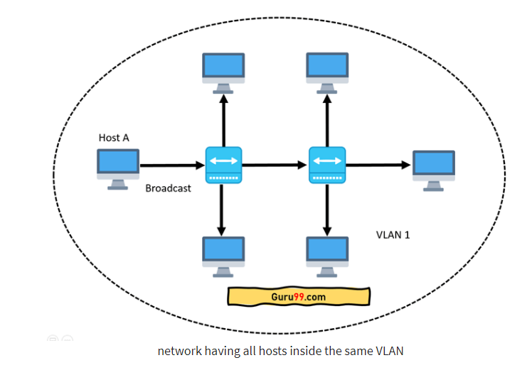
Virtual LAN (VLAN)
The below topology depicts a network having all hosts inside the same virtual LAN:
a broadcast sent from a host can easily reach all network devices. Each and every device will process broadcast received frames.
Adapted from https://www.guru99.com/
2-<number>

Slide 4
VLAN Types
Static vs. Dynamic VLAN
  Static VLAN: also known as Port-based VLANs are created by manually assigning ports to a VLAN.
  When a device is connected to a port it automatically assumes the VLAN that the port is assigned to.
  If the user changes the port and still needs to access the same VLAN, the network administrator has to manually assign the port to the VLAN.
  Dynamic VLAN: dynamic VLANs are created by assigning the host to a VLAN when a host is plugged in to a switch using hardware addresses stored in a database.
  Dynamic VLANs use a central server called VMPS (VLAN Membership Policy Server).
  VMPS is used to handle port configurations of every switch on the VLAN network.
Adapted from https://www.guru99.com/
2-<number>

Slide 5
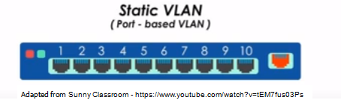
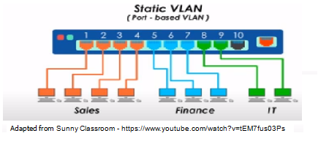
VLAN Types
Adapted from Sunny Classroom - https://www.youtube.com/watch?v=tEM7fus03Ps
2-<number>

Slide 6
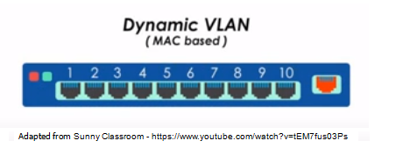
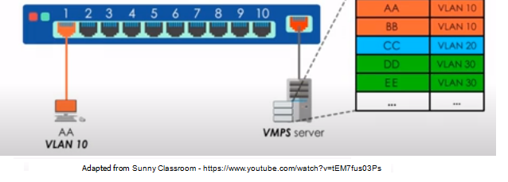
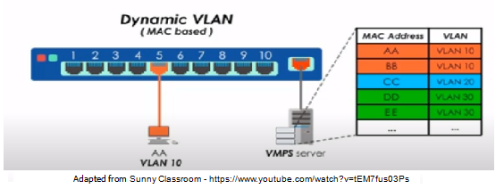
VLAN Types
Adapted from Sunny Classroom - https://www.youtube.com/watch?v=tEM7fus03Ps
2-<number>

Slide 7
Chapter 2: outline
2.1 principles of network applications
2.2 Web and HTTP
2.3 FTP
2.4 electronic mail
  SMTP, POP3, IMAP
2.5 DNS
2.6 P2P applications
2.7 socket programming with UDP and TCP
Adapted from J.F Kurose and K.W. Ross March 2012
Application Layer
2-<number>

Slide 8

















Creating a network app
application
transport
network
data link
physical
write programs that:
run on (different) end systems
e.g., web server software communicates with browser software
no need to write software for network-core devices
network-core devices do not run user applications
application
transport
network
data link
physical
application
transport
network
data link
physical
Adapted from J.F Kurose and K.W. Ross March 2012
Application Layer
2-<number>

Slide 9
Application architectures
possible structure of applications:
client-server
peer-to-peer (P2P)
Adapted from J.F Kurose and K.W. Ross March 2012
Application Layer
2-<number>

Slide 10
Client-server architecture
server:
always-on host
permanent IP address
data centers for scaling
clients:
communicate with server
may be intermittently connected
may have dynamic IP addresses
do not communicate directly with each other
client/server
Adapted from J.F Kurose and K.W. Ross March 2012
Application Layer
2-<number>

Slide 11
P2P architecture
no always-on server
arbitrary end systems directly communicate
peers request service from other peers, provide service in return to other peers
peers are intermittently connected and change IP addresses
  complex management
peer-peer
Adapted from J.F Kurose and K.W. Ross March 2012
Application Layer
2-<number>

Slide 12
Processes communicating
process: program running within a host
within same host, two processes communicate using inter-process communication (defined by OS)
processes in different hosts communicate by exchanging messages
clients, servers
client process: process that initiates communication
server process: process that waits to be contacted
Applications with P2P architectures have client processes & server processes
Adapted from J.F Kurose and K.W. Ross March 2012
Application Layer
2-<number>

Slide 13

Sockets
process sends/receives messages to/from its socket
socket analogous to door
  sending process shoves message out door
  A socket is the interface between the application layer and the transport layer within a host.
application
socket
application
controlled by
app developer
process
process
transport
transport
network
network
controlled
by OS
link
Internet
link
physical
physical
Adapted from J.F Kurose and K.W. Ross March 2012
Application Layer
2-<number>

Slide 14
Addressing processes
to receive messages, process must have identifier
host device has unique 32-bit IP address
Q: does IP address of host on which process runs suffice for identifying the process?
identifier includes both IP address and port numbers associated with process on host.
example port numbers:
  HTTP server: 80
  mail server: 25
to send HTTP message to gaia.cs.umass.edu web server:
  IP address: 128.119.245.12
  port number: 80
more shortly…
  A: no, many processes can be running on same host
Adapted from J.F Kurose and K.W. Ross March 2012
Application Layer
2-<number>

Slide 15

IP addresses

Slide 16
App-layer protocol defines
types of messages exchanged,
  e.g., request, response
message syntax:
  what fields in messages & how fields are delineated
message semantics
  meaning of information in fields
rules for when and how processes send & respond to messages
open protocols:
defined in RFCs
e.g., HTTP, SMTP
proprietary protocols:
e.g., Skype
Adapted from J.F Kurose and K.W. Ross March 2012
Application Layer
2-<number>

Slide 17
What transport service does an app need?
data integrity
timing
some apps (e.g., Internet telephony, interactive games) require low delay to be “effective”
security
encryption…
throughput
Adapted from J.F Kurose and K.W. Ross March 2012
Application Layer
2-<number>

Slide 18
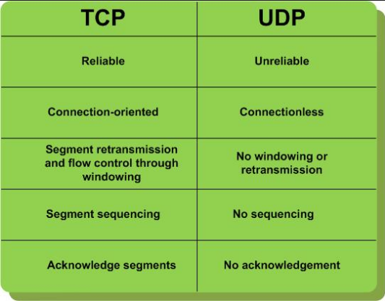
Internet transport protocols services
Adapted from J.F Kurose and K.W. Ross March 2012
Application Layer
2-<number>

Slide 19
Internet transport protocols services
UDP: Anything where you don't care too much if you get all data always
    Tunneling/VPN (lost packets are ok - the tunneled protocol takes care of it)
    Media streaming (lost frames are ok)
    Games that don't care if you get every update
TCP: Almost anything where you have to get all transmitted data
    Web
    FTP
    SMTP, sending mail
    IMAP/POP, receiving mail
Adapted from J.F Kurose and K.W. Ross March 2012
Application Layer
2-<number>

Slide 20
Internet apps: application, transport protocols
application
layer protocol
SMTP [RFC 2821]
Telnet [RFC 854]
HTTP [RFC 2616]
FTP [RFC 959]
HTTP (e.g., YouTube),
RTP [RFC 1889]
SIP, RTP, proprietary
(e.g., Skype)
underlying
transport protocol
TCP
TCP
TCP
TCP
TCP or UDP
TCP or UDP
application
e-mail
remote terminal access
Web
file transfer
streaming multimedia
Internet telephony
Adapted from J.F Kurose and K.W. Ross March 2012
Application Layer
2-<number>

Slide 21
Securing TCP
TCP & UDP
no encryption
SSL
provides encrypted TCP connection
data integrity
end-point authentication
SSL is at app layer
Apps use SSL libraries, which “talk” to TCP
Adapted from J.F Kurose and K.W. Ross March 2012
Application Layer
2-<number>

Slide 22
Chapter 2: outline
2.1 principles of network applications
  app architectures
  app requirements
2.2 Web and HTTP
2.3 FTP
2.4 electronic mail
  SMTP, POP3, IMAP
2.5 DNS
2.6 P2P applications
2.7 socket programming with UDP and TCP
Adapted from J.F Kurose and K.W. Ross March 2012
Application Layer
2-<number>

Slide 23
Web and HTTP
First, a review…
web page consists of objects
object can be HTML file, JPEG image, Java applet, audio file,…
web page consists of base HTML-file which includes several referenced objects
each object is addressable by a URL, e.g.,
www.someschool.edu/someDept/pic.gif
host name
path name
Adapted from J.F Kurose and K.W. Ross March 2012
Application Layer
2-<number>

Slide 24

HTTP overview
HTTP request
PC running
Firefox browser
HTTP response
HTTP request
server
running
Apache Web
server
HTTP response
iphone running
Safari browser
Adapted from J.F Kurose and K.W. Ross March 2012
Application Layer
2-<number>

Slide 25
HTTP overview (continued)
uses TCP:
client initiates TCP connection (creates socket) to server, port 80
server accepts TCP connection from client
HTTP messages (application-layer protocol messages) exchanged between browser (HTTP client) and Web server (HTTP server)
TCP connection closed
HTTP is “stateless”
server maintains no information about past client requests
Adapted from J.F Kurose and K.W. Ross March 2012
Application Layer
2-<number>

Slide 26
HTTP connections
non-persistent HTTP
at most one object sent over TCP connection
  connection then closed
downloading multiple objects required multiple connections
persistent HTTP
multiple objects can be sent over single TCP connection between client, server
Adapted from J.F Kurose and K.W. Ross March 2012
Application Layer
2-<number>

Slide 27
Non-persistent HTTP
suppose user enters URL:
(contains text,
references to 10
jpeg images)
www.someSchool.edu/someDepartment/home.index
1a. HTTP client initiates TCP connection to HTTP server (process) at www.someSchool.edu on port 80
1b. HTTP server at host www.someSchool.edu waiting for TCP connection at port 80. “accepts” connection, notifying client
2. HTTP client sends HTTP request message (containing URL) into TCP connection socket. Message indicates that client wants object someDepartment/home.index
3. HTTP server receives request message, forms response message containing requested object, and sends message into its socket
time
Adapted from J.F Kurose and K.W. Ross March 2012
Application Layer
2-<number>

Slide 28
Non-persistent HTTP (cont.)
4. HTTP server closes TCP connection.
5. HTTP client receives response message containing html file, displays html. Parsing html file, finds 10 referenced jpeg objects
time
6. Steps 1-5 repeated for each of 10 jpeg objects
Adapted from J.F Kurose and K.W. Ross March 2012
Application Layer
2-<number>

Slide 29
Non-persistent HTTP: response time
RTT (round-trip time (RTT)): time for a small packet to travel from client to server and back
HTTP response time:
one RTT to initiate TCP connection
one RTT for HTTP request and first few bytes of HTTP response to return
file transmission time
non-persistent HTTP response time =
  2RTT+ file transmission time
initiate TCP
connection
RTT
request
file
RTT
time to
transmit
file
file
received
time
time
Adapted from J.F Kurose and K.W. Ross March 2012
Application Layer
2-<number>

Slide 30
Persistent HTTP
non-persistent HTTP issues:
requires 2 RTTs per object
browsers often open parallel TCP connections to fetch referenced objects
persistent HTTP:
server leaves connection open after sending response
subsequent HTTP messages between same client/server sent over open connection
client sends requests as soon as it encounters a referenced object
as little as one RTT for all the referenced objects
Adapted from J.F Kurose and K.W. Ross March 2012
Application Layer
2-<number>

Slide 31
Persistent HTTP
Non-persistent HTTP issues:
Connection setup for each request
But browsers often open parallel connections
Persistent HTTP:
Server leaves connection open after sending response
Subsequent HTTP messages between same client/server are sent over connection
Persistent without pipelining:
Client issues new request only when previous response has been received
One RTT for each object
Persistent with pipelining:
Default in HTTP/1.1 spec
Client sends multiple requests
As little as one RTT for all the referenced objects
Server must handle responses in same order as requests

Slide 32
HTTP request message
two types of HTTP messages: request, response
HTTP request message:
  ASCII (human-readable format)
Compression methods
request line
(GET, POST,
HEAD commands)
GET /index.html HTTP/1.1\r\n
Host: www-net.cs.umass.edu\r\n
User-Agent: Firefox/3.6.10\r\n
Accept: text/html,application/xhtml+xml\r\n
Accept-Language: en-us,en;q=0.5\r\n
Accept-Encoding: gzip,deflate\r\n
Accept-Charset: ISO-8859-1,utf-8;q=0.7\r\n
Keep-Alive: 115\r\n
Connection: keep-alive\r\n
\r\n
header
lines
I prefer english US, but will accept other types of English
the character encodings
Adapted from J.F Kurose and K.W. Ross March 2012
Application Layer
2-<number>

Slide 33
HTTP request message
What does Keep-Alive mean?
  This means it is OK to keep the connection open to ask for more resources like for example images.
  What does q=0.5 mean?
  Each language-range may be given an associated quality value which represents an estimate of the user's preference for the languages specified by that range. The quality value defaults to "q=1".
  \r = CR (Carriage Return)
  \n = LF (Line Feed)
  \r\n = CR + LF // Used as a new line
Adapted from J.F Kurose and K.W. Ross March 2012
Application Layer
2-<number>

Slide 34
HTTP request message
  HTTP 1.1 allows you to have persistent connections which means that you can have more than one request/response on the same HTTP connection.
  In HTTP 1.0 you had to open a new connection for each request/response pair. And after each response the connection would be closed. This lead to some big efficiency problems because of TCP Slow Start.
Adapted from J.F Kurose and K.W. Ross March 2012
Application Layer
2-<number>

Slide 35
HTTP request message: general format
method
sp
URL
sp
version
cr
request
line
lf
header field name
value
cr
lf
~
~
header
lines
~
~
header field name
value
cr
lf
cr
lf
~
entity body
~
body
~
~
Adapted from J.F Kurose and K.W. Ross March 2012
Application Layer
2-<number>

Slide 36
The end
Application Layer
2-<number>

